Slide 1
Storytelling
Introduction to Data Visualization
The Graduate Center at CUNY
Michelle A. McSweeney

Slide 2
Forum Discussion
Take 5 minutes to summarize a favorite story to your neighbor

Slide 3
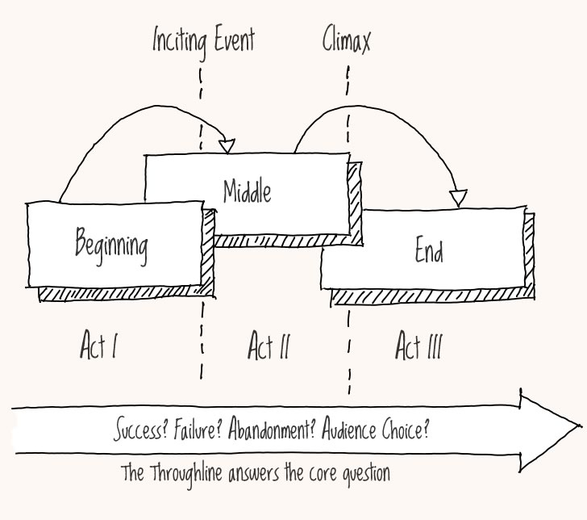
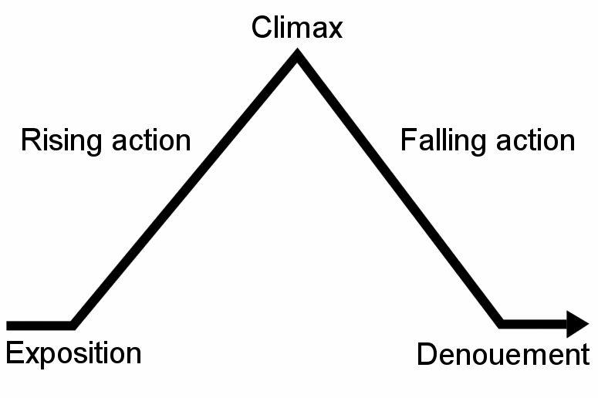
Narrative
Freytag’s Pyramid
Notes:
Western cannon cites Aristotle’s Poetics: beginning/middle/end

Slide 4
Narrative in Data: 6 story Arcs in Western Lit
Constant rise (rags-to-riches)
Constant fall (tragedies)
Fall and rise (man-in-a-hole)
Rise and fall (Icarus)
Rise-fall-rise
Fall-rise-fall (Oedipus)
https://arxiv.org/abs/1606.07772
Notes:
Sentiment analysis

Slide 5
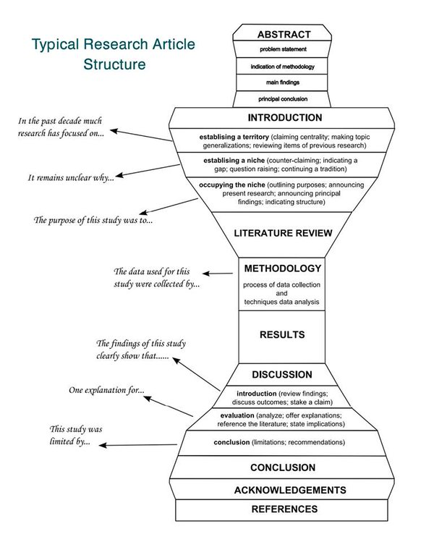
Author-Centered Stories
Research Question
Data
Methods
Results
Conclusion
https://umc.libguides.com/c.php?g=685373&p=4843026
Notes:
This is the path we take through the data, so we lead others onto it

Slide 6
Reader-centered (data) stories
Begin with the finale
Engage
Expose
Explain
Extrapolate
What will I learn from this visualization?
What questions/data led you there?
Where is the hook?
Notes:
Start with the ending
How did we get there?
One big take away
Beginning/Middle/End

Slide 7
Hooks, Ledes, and Other Nice Things
Why?
Grab attention
Develop an emotional connection
Compel someone to invest their time
Make meaning
How?
Title
Expose the ending in a sentence
Expose the ending in a rhetorical question
Shocking numbers
Present a question(s)

Slide 8
Cut Cut Cut
Remove any charts that do not make your point
Make your point as clearly as possible as early as possible
Reinforce the logic that you came to AFTER you make your point
Digging deeper belongs in the appendix
Break these rules as relevant

Slide 9
Storyboarding
The ending: 1 major takeaway you want your audience to get
All of the subpoints that will get you there
The problem or tension
Future implications
Discard pile

Slide 10
Storyboarding - organization
Engage / set conflict
Insight 1
Insight 2+ (optional)
Big insight to resolve conflict
Implications

