Slide 1
Maps
Introduction to Data Visualization
The Graduate Center at CUNY
Michelle A. McSweeney

Slide 2
A question
What makes a map different from a visualization?
What makes a map different from an image?

Slide 4
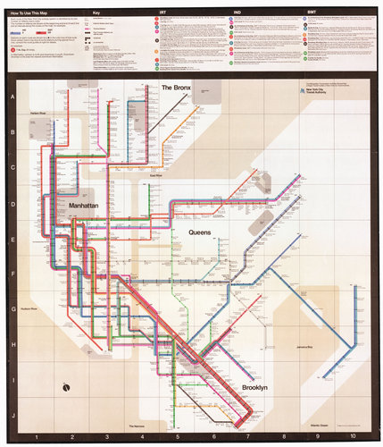

Slide 5
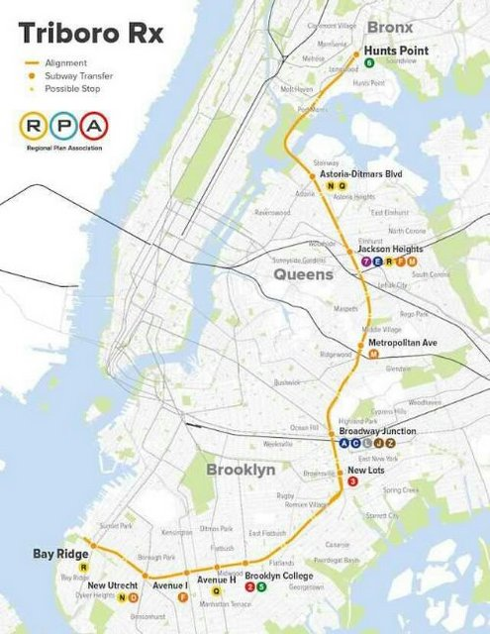

Slide 6
Maps As…
Referents
Event is happening in this place
Proxy for spatial categories
Containers
Map boundaries are essential to the visualization
Spatial Analysis
New findings by combining spatial datasets

Slide 7
Maps to represent…
People
Places
Things
Events
… All against a backdrop of space/location

Slide 8
Thematic Mapping: Numerical Chloropleth

Slide 9
Thematic Mapping: Categorical Chloropleth

Slide 10
Thematic mapping: Categorical Chloropleth
Six ethnographical maps, illustrative of "The natural history of man," and "Researches into the physical history of mankind." By James Cowles Prichard 1851

Slide 11
Thematic Mapping
Stacked Bar Chart
www.lucify.com/the-flow-towards-europe/
Graduated Symbols
www.therefugeeproject.org/#/2016
Wind Map
hint.fm/wind

Slide 12
Space is subjective

Slide 13
Cartographic facts are only facts within a specific cultural perspective. We start to understand how maps are far from being “a transparent opening to the world” are but “a particular human way… of looking at the world.”
Harley, pg 3

Slide 14
Notes:
Mercator Projection

Slide 15
Notes:
Robinson Projection similar to Winkel-Triple, NatGeo’s fav

Slide 16
Notes:
Peterson Projection

Slide 20
Geoid

Slide 21
BUT… Statistics is subjective

Slide 22
Notes:
Natural Breaks

Slide 23
Notes:
Equal Intervals

Slide 25
Chloropleth & Small Multiples
https://www.nytimes.com/interactive/2017/08/07/upshot/music-fandom-maps.html?mcubz=3

Slide 26
Spatial Analysis
www.subwaylanguages.
michelleajohnson.com
Versus
https://tubecreature.com/#/tongues/current/same/*/*/FTTTTF/13/-0.1500/51.5200/
Using the concept of space in a non-map visualization
Using graduated symbols against 2 geographies

Slide 27
Cultural Analysis
https://www.ucpress.edu/blog/wp-content/uploads/2016/12/CityofWomen_SolnitNMNY.png
Using a basemap as a the referent to re-imagine a world

Slide 29
Traps in Normalization & Causation vs. Correlation

Slide 30
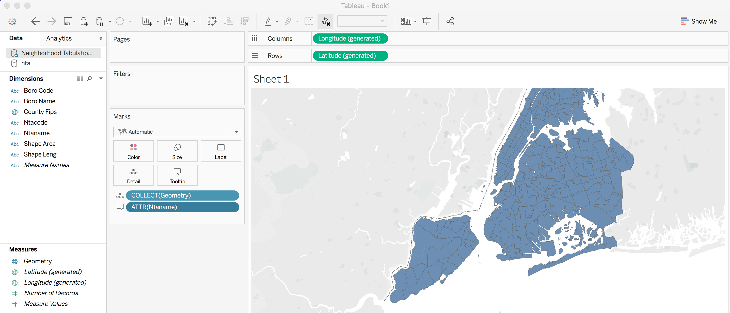
Adding Shape Files
https://data.cityofnewyork.us/City-Government/Neighborhood-Tabulation-Areas/cpf4-rkhq
Geojson or KML are easiest (can use ESRI or MapInfo)

